Slide 1
L4_Dictionaries
Dr. Jay Dave
CSIS Dept, Hyderabad Campus

Slide 2
Data Structures and Algorithms Design (Merged-SEZG519/SSZG519)
L4_Dictionaries

Slide 3
Content of L-4
4.1. Unordered Dictionary
4.1.1. ADT Specification
4.1.2. Applications
4.2. Hash Tables
4.2.1. Notion of Hashing and Collision (with a simple vector based hash table)
4.2.2. Hash Functions
4.2.2.1. Properties
4.2.2.2. Simple hash functions
4.2.3. Methods for Collision Handling
4.2.3.1. Separate Chaining
4.2.3.2. Notion of Load Factor
4.2.3.3. Rehashing
4.2.3.4. Open Addressing [ Linear & Quadratic Probing, Double Hash]

Slide 4
Content of L-4
4.3. Ordered Dictionary
4.3.1. ADT Specification
4.3.2. Applications
4.4. Binary Search Tree
4.4.1. Motivation with the task of Searching and Binary Search Algorithm
4.4.2. Properties of BST
4.4.3. Searching an element in BST
4.4.4. Insertion and Removal of Elements
4.4.5. Performance

Slide 5
Dictionaries
A computer dictionary is similar to paper dictionary of words.
Main idea: Users can assign key to elements and use keys to look up/remove elements.
Procedures: Insertion, Removal, and Searching of elements through keys.

Slide 6
Dictionaries
A dictionary stores key-element pairs (k, e).
E.g.: keys = students' ID and elements = {students' name, address, and course grades}
Two types: Unordered dictionary and ordered dictionary.

Slide 7
Unordered Dictionaries
A dictionary stores key-element pairs (k, e) where key is not sorted.
Operations are:
findElement(k)
insertltem(k,e)
removeElement(k)
size()
isEmpty()
findAllElements(k)
removeAllElements(k)

Slide 8
Unordered Dictionaries:
Log files
A vector or list of key-elements pair
insertitem(k,e) is easy as new item is inserted at last. All cases: O(1)
findElement(k) and removeElement(k) are costly operations. Worst case: O(n)

Slide 9
Hash tables
One of the most efficient ways to implement dictionary
Bucket arrays
an array of size N, where each cell of array is a "bucket" (i.e., a container of key-element pairs).
Collision: When keys are not unique, two different elements may be mapped to the same bucket.

Slide 10
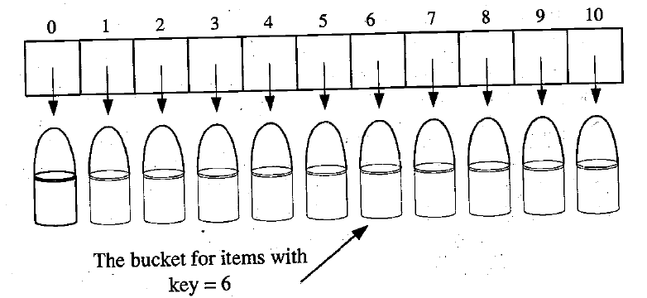
Hash tables

Slide 11
Hash tables
If keys are unique, then insert, search, delete takes O(1).
bucket size = some bucket may be empty
If keys are not unique, then insert, search, delete takes more than O(1).

Slide 12
Hash Functions
Maps each key in our dictionary to an integer in range [0, N-1], where N is capacity of bucket array for this table.
h(k). We store key and element at A[h(k)].
A hash function is good if it maps the keys in our dictionary so as to minimize collisions.
For practical reasons, hash functions to be fast and easy to compute

Slide 13
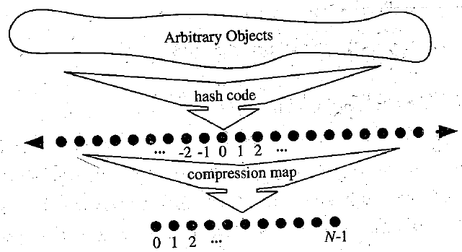
Hash Functions
Generally, we view evaluations of a hash function, h(k) is mapping key to an integer, i.e., hash code.
Then, mapping hash code to an integer of bucket array, i.e., compression map.

Slide 14
Compression maps
Division method
h(k) = |k| mod N
If N is prime, then compression map spreads out the distribution of hash values well. If N is not prime, then collisions possible.
E.g. {200, 205, 210, ..., 600} to be mapped to bucket array of size 100. Then each hash code will collide with five others. 200, 300, 400, 500, 600 have collision. If array size is 101, then no collision.
MAD method (Multiply Add and Divide)
h(k) = ((a*k+b)%p)%N, where p = prime number > N, a = [1..(p-1)], b = [0..(p-1)]

Slide 15
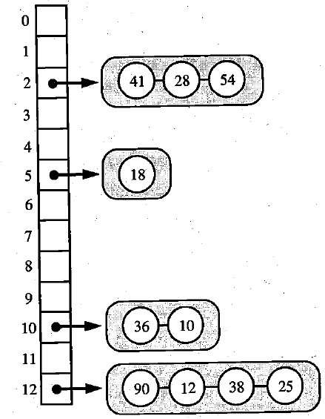
Collision handling schemes
A[h(k)] stores k and e.
Collisions: h(k1) = h(k2), k1 != k2
Separate chaining
Simplest way: Use Si, i.e., list/vector/sequence for each A[i], where Si can be viewed as unordered sequence/log file.

Slide 16
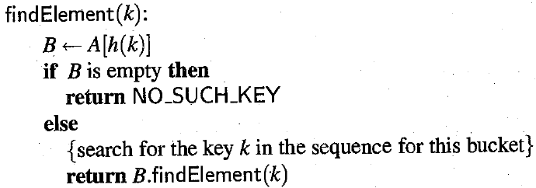
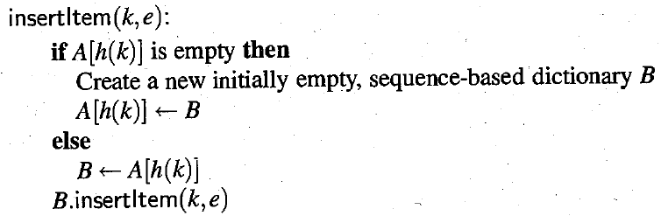
Collision handling schemes (Separate chaining)

Slide 17
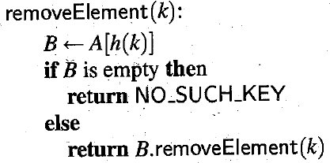
Collision handling schemes (Separate chaining)

Slide 18
Collision handling schemes
Load factors and Rehashing
Assuming n items in bucket array of size N, we expect each bucket to be size ceil(n/N).
That is load factor, preferably near to ceil(n/N).
Time complexity to find, insert, and remove O(ceil(n/N)).
In order to keep load factor a constant value, we need to increase size of bucket array and change compression map. That is rehashing.

Slide 19
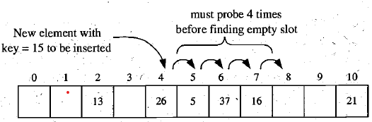
Collision handling schemes
Open addressing
Separate chaining requires additional data structure to hold keys.
To avoid occupying extra space, open addressing is used.
Linear probing
If we try to insert item at A[i] that is already occupied, then try A[(i+1) mod N]. Then, A[(i+2) mod N]. And so on.
Search: Start searching from A[h(k)] and consecutive buckets.
Delete: It is complicated. We should restore the content of bucket array to look as though item with key k was never inserted in its bucket A[i] in first place. (1) shifting, (2) deactivate item and ignore this item while searching too.

Slide 20
Collision handling schemes
Quadratic probing:
A[i+f(j) mod N], j=0,1,... where f(j) = j², until finding an empty bucket.
If N is not prime, quadratic probing may not find empty bucket in A even if one exists.
Even if N is prime, strategy may not find an empty slot, if bucket array is at least half full.
Double hashing
We choose secondary hash function, h₂.
If h maps some key k to bucket A[i], with i = h₁(k), then we iteratively try buckets A[(i+(j*h₂(k)) mod N], for j = 1, 2,...,N - 1.
We should choose a secondary hash function that will attempt to minimize clustering as much as possible.

Slide 21
Collision handling schemes
0 | 13
1 | 9
2 | 12
3
4
5 | 6
6 | 11
7 | 2
8 | 7
9 | 3
(2k +3) mod 10 |  | Linear | Quad
3 | 9 | 1 | 1
2 | 7 | 1 | 1
9 | 1 | 1 | 1
6 | 5 | 1 | 1
11 | 5 | 2 | 2
13 | 9 | 2 | 2
7 | 7 | 2 | 2
12 | 7 | 6 | 5
0 | 13
1 | 9
2
3 | 12
4
5 | 6
6 | 11
7 | 2
8 | 7
9 | 3
Linear probing
A[(i + j) mod N]
Quadratic probing
A[(i + j²) mod N]
Input: 3, 2, 9, 6, 11, 13, 7, 12
h(k) = (2k + 3) mod 10

Slide 22
Collision handling schemes
0
1 | 9
2
3 | 11
4 | 12
5 | 6
6
7 | 2
8
9 | 3
 | h₁(k) | h₂(k)
3 | 9 |  | 1
2 | 7 |  | 1
9 | 1 |  | 1
6 | 5 |  | 1
11 | 5 | 4 | 3
13 | 9 | 0 | --
7 | 7 | 2 | --
12 | 7 | 7 | 2
Input: 3, 2, 9, 6, 11, 13, 7, 12
h₁(k) = (2k + 3) mod 10, h₂(k) = (3k + 1) mod 10
A[(h₁(k)+(j*h₂(k))) mod N]

Slide 23
Collision handling schemes
Linear Probing
https://quescol.com/data-structure/linear-probing
Quadratic Probing
https://www.geeksforgeeks.org/quadratic-probing-in-hashing/
Double Hashing
https://www.geeksforgeeks.org/double-hashing/
https://carmencincotti.com/2022-10-24/double-hashing-open-addressing-hash-tables/#:~:text=An%20example,-Consider%20an%20example&text=Assume%20k%20is%20an%20integer.&text=I%20would%20like%20to%20insert,(10)%3D0.&text=Our%20formula%20returns%20the%20index,hash%20table%20is%20already%20occupied!&text=We're%20done!

Slide 24
Collision handling schemes
Separate chaining | Linear probing | Quadratic probing | Double hashing
Pros: Simple to implement. Handles a large number of collisions well. Cons: Requires additional memory for storing linked lists. Poor cache locality due to pointer-based data structure. | Pros: Cache-friendly due to contiguous memory access. No additional memory overhead for storing linked lists. Cons: May suffer from clustering (long consecutive sequences of occupied slots). Degraded performance when the load factor is high. | Pros: Reduces clustering compared to linear probing. Avoids primary clustering (clustering at the initial position). Cons: May still suffer from secondary clustering (clustering away from the initial position). Requires additional arithmetic computations. | Pros: Reduces clustering compared to linear probing and quadratic probing. Provides good performance with proper choice of hash functions. Cons: Requires the design and calculation of two hash functions. Complexity increases with the need for collision resolution using two hash functions.

Slide 25
Ordered Dictionaries
A dictionary stores key-element pairs (k, e) where key is sorted.
Sorted tables and binary search
mid = (low+high)/2
if (A[mid] = key) then
print “item found”
else if (A[mid] < key) then
low = mid + 1
else
high = mid - 1
Binary search trees

Slide 26
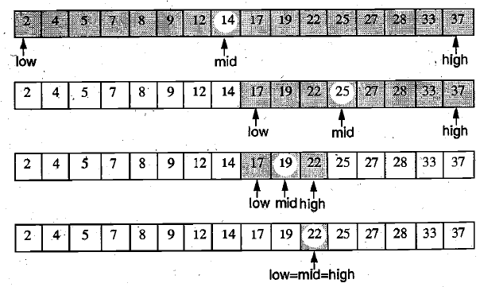
Ordered Dictionaries
Search (22)

Slide 27
Binary Search Tree
Binary Search Tree (BST) is a binary tree that satisfies the following properties:
For i^{th} node,
Its left subtree nodes have lower value than i^{th} node.
Its right subtree nodes have higher (or equal) value than i^{th} node.
Operations: 1) Search, 2) Insert, 3) Delete, 4) Traverse

Slide 28
Binary Search Tree (Search)
Algorithm BST_Search(item)
ptr ← root
while (ptr ≠ NULL) do
if ptr.data = item then
print “item found”
return ptr
else if item < ptr.data then
ptr ← ptr.left
else
ptr ← ptr.right
print “item not found”
return NULL

Slide 29
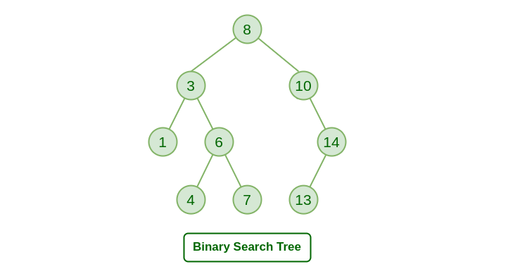
Binary Search Tree (Search)

Slide 30
Binary Search Tree (Insert)
Algorithm BST_Insert(item)
ptr ← root
while ptr ≠ NULL do
if ptr.data = item then
print “item already exists”
exit
else if item < ptr.data then
ptr1 ← ptr
ptr ← ptr.left
else
ptr1←ptr
ptr ← ptr.right
new ← getnode( )
new.data ← item
new.left ← NULL
new.right ← NULL
if ptr1.data < item
ptr1.right ← new
else
ptr1.left ← new

Slide 31
Binary Search Tree (Insert)

Slide 32
Binary Search Tree (Delete)
Case 1: N is a leaf node
➔ Delete the node
Case 2: N has exactly one child
➔ Replace N with its child node
Case 3: N has two child nodes
➔ Replace N with SUCC(N) where SUCC(N) is successor of N in inorder traversal.

Slide 33
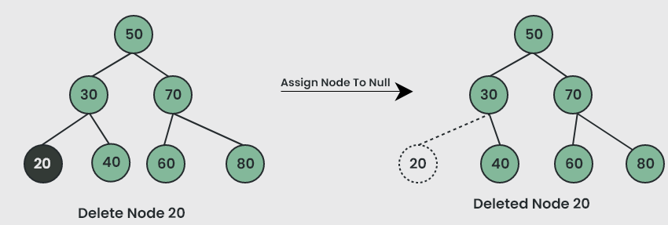
Binary Search Tree (Delete)
Case 1: N is a leaf node

Slide 34
Binary Search Tree (Delete)
Case 2: N has exactly one child

Slide 35
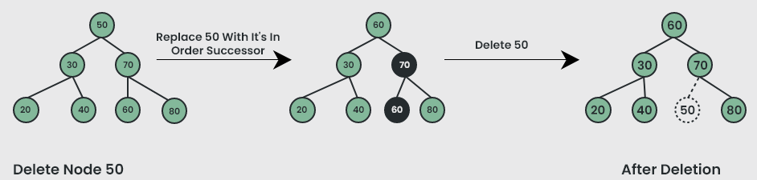
Binary Search Tree (Delete)
Case 3: N has two child nodes
Inorder: 20,30,40,50,60,70,80

Slide 36
Binary Search Tree (Insert)
Algorithm BST_Delete(item)
ptr ← SEARCH(item)
if ptr = NULL then
print “item not found”
exit
if ptr.left = NULL and ptr. right = NULL then //Case 1
if parent(ptr).left = ptr then
parent(ptr).left ← NULL
else
parent(ptr).right ← NULL
print “item deleted”
free(ptr)
else if ptr.left = NULL or ptr. right = NULL then //Case 2
child ← ptr.left ≠ NULL ? ptr.left : ptr.right
if parent(ptr).left = ptr then
parent(ptr).left ← child
else
parent(ptr).right ← child
print “item deleted”
free(ptr)
else //Case 3
ptr1 ← SUCC(ptr)
item1 ← ptr1.data
BST_Delete(item1)
ptr.data ← item1

Slide 37
Binary Search Tree (Inorder succcessor)
Algorithm SUCC(ptr)
ptr1 ← ptr.right
if ptr1 ≠ NULL then
while ptr1.left ≠ NULL do
ptr1 ← ptr1.left
return ptr
Successor of xth node in inorder is leftmost node in right subtree of x.

Slide 38
Additional topics
AVL Tree
Red Black Tree
B Tree
B+ Tree

Slide 39
References
Algorithms Design: Foundations, Analysis and Internet Examples Michael T. Goodrich, Roberto Tamassia, 2006, Wiley (Students Edition)
Data Structures, Algorithms and Applications in C++, Sartaj Sahni, Second Ed, 2005, Universities Press
Introduction to Algorithms, TH Cormen, CE Leiserson, RL Rivest, C Stein, Third Ed, 2009, PHI

Slide 40
Any Question!!

Slide 41
Thank you!!

